Slide 1
Identifying animals in camera trap footage
The island conservation dataset
by Lena Schwertmann
Module: Machine Learning Lab
Examiner: Prof. Ulf Brefeld
Date: November 24, 2020

Slide 2

Motivation
Why camera traps?
non-invasive method to monitor wildlife
Why islands?
exceptionally high biodiversity
endangered due to invasive species (rats, cats, etc.)
Why me?
background in biology
Notes:
motivation

Slide 3

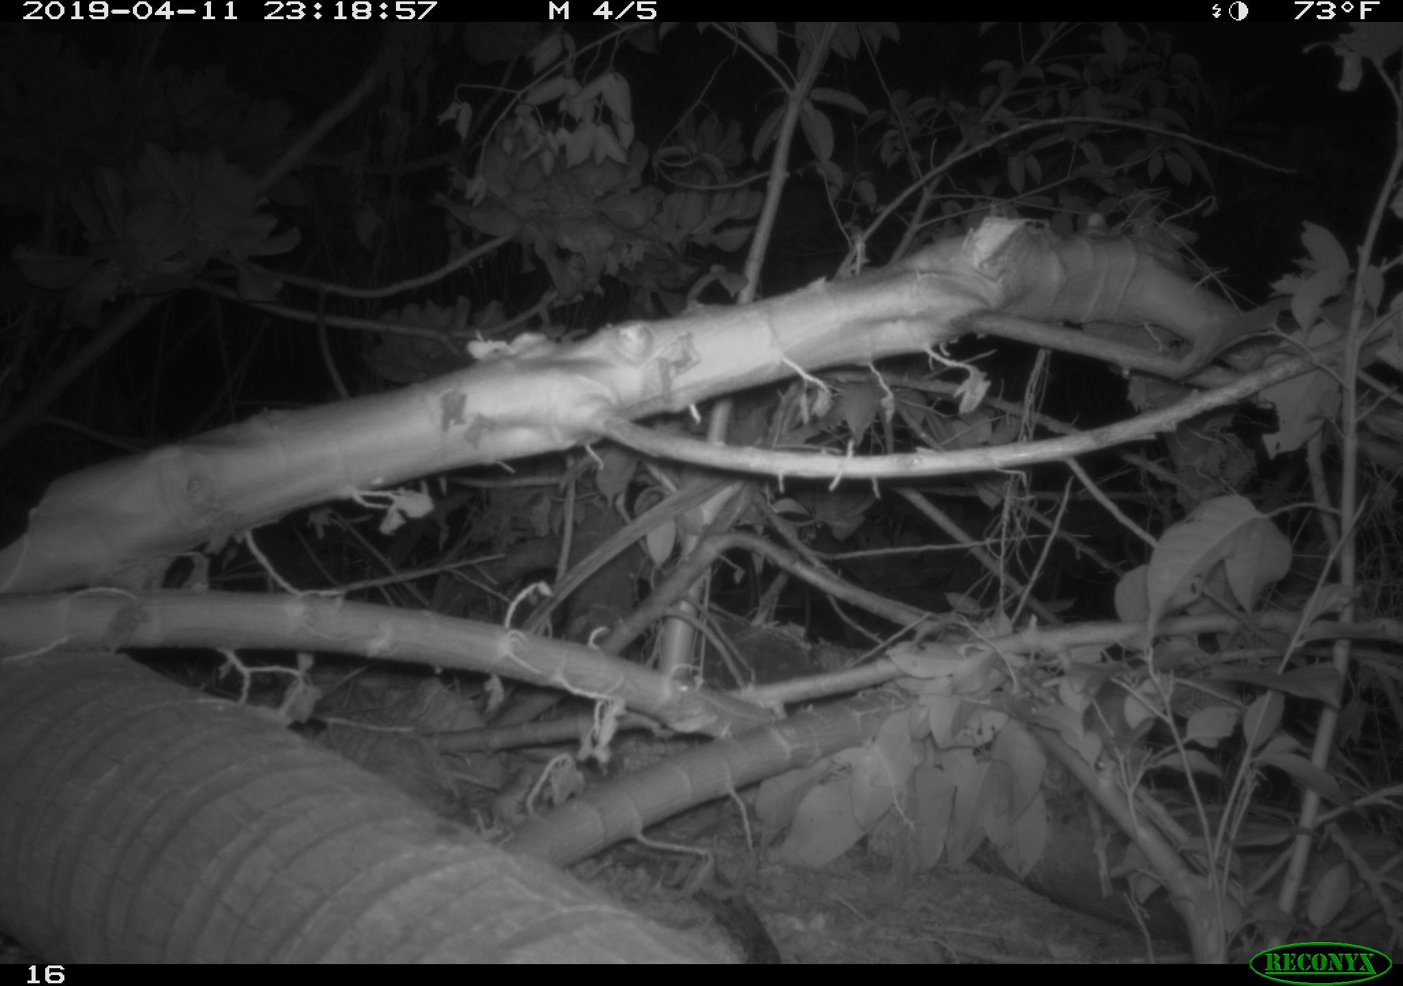
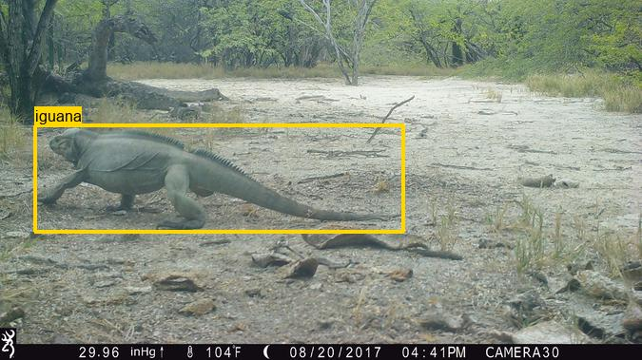
Data
What?
→ 100k labeled images from camera traps
→ 50% images with bounding boxes
→ 60% empty, 47 animal classes, very imbalanced
→ day & night-time
→ bursts of 3-8 photos when motion detected
Where?
→ 7 islands in 6 countries (Pacific Ocean & Caribbean)
Micronesia, Ulithi Atoll
Dominican Republic, Cabritos Island

Slide 4

Baseline & Model
Baseline: majority class
= always predicting an empty image
Model: Convolutional Neural Networks (CNNs)
default method for image data
finding a suitable architecture
number & size & types of convolutions
pooling
number & size of fully connected layers
start with insights from literature (ResNet-18)

Slide 5
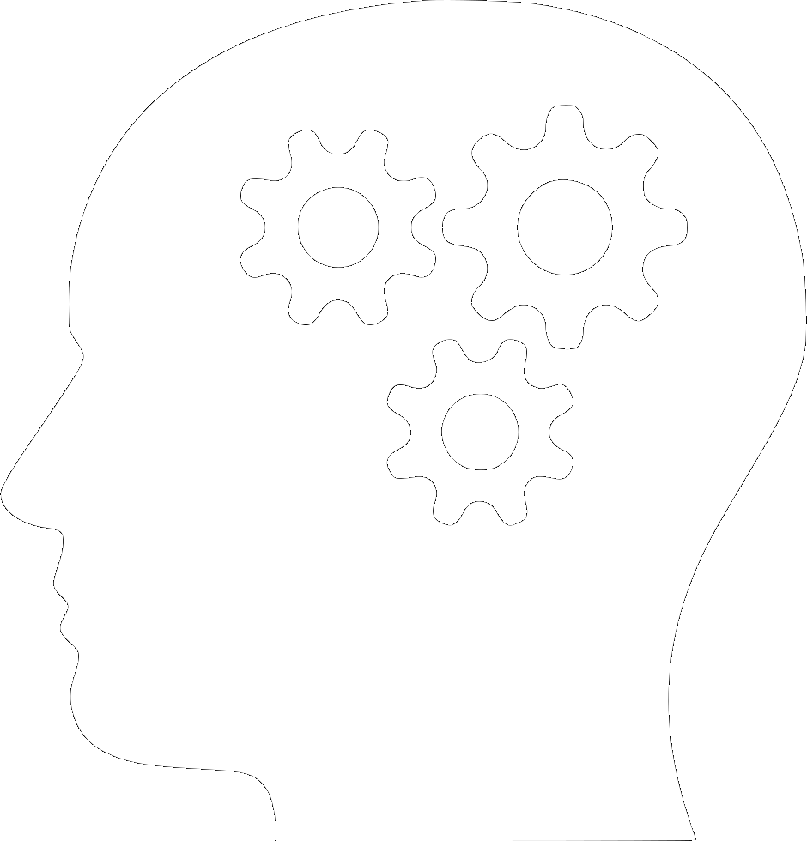
Outlook
Decide for preprocessing steps
resizing, data augmentation,...
Literature Research
→ What has previously been done and why?
→ Transfer learning vs. training from scratch
→ ensemble learning: top-1 vs. top-5 score

